Slide 1
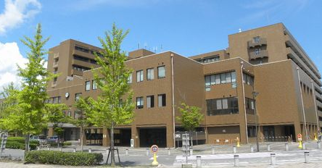
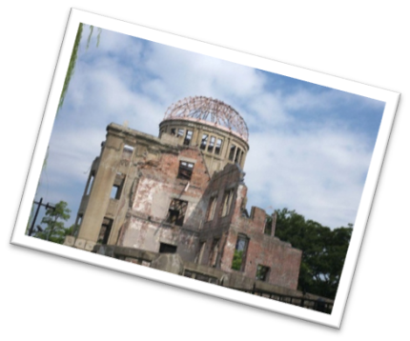
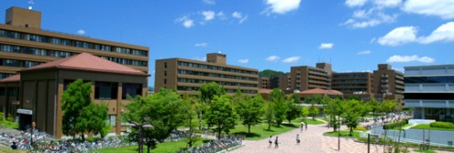
Hiroshima University Summer Program 2016
Introduction to
Advanced and Integrated Science
Hiroshima University Campus
Discover the Joy of Science! Experience Hiroshima!
Date: August 1 – August 7, 2016 (7 days)
Location: Graduate School of Science
Hiroshima University
Costs: Travel expenses to and from Hiroshima (airfare, railway and/or bus fares), insurance fees, medical expenses etc.
* Participation fees (tuition fee,
textbook, study tour expenses etc.)
are exempted and accommodation
are provided.
Application Deadline: May 27, 2016
Program:
Study advanced and Integrated Science; Mathematics, Physical Science, Chemistry, Biological Science, Earth and Planetary System Science, Mathematical Life Science.
Experience Japanese Culture
Visit UNESCO World Heritage Sites
Miyajima (Japanese traditional red ‘TORII’ gate on the sea),
A-bomb Dome, Peace Park, Attend the Peace Memorial Ceremony, etc.
Exchange with students at Hiroshima University, campus tours and more!
HIROSHIMA UNIVERSITY
http://www.hiroshima-u.ac.jp/index.html
Notes:
Please leave us a 5 Star Rating if you love how this works for you! Feedback? Didn’t print right? Let us know so that I can fix it! Email us: support@supereasytemplates.com.
Welcome to Super Easy Templates: This is an 8 x 11 PowerPoint Flyer/Poster/Presentation that consists of one page. Great for retirement, timeshare, travel, resort, hotel or family-oriented presentation. We provide easy-to-use and customize templates for home and business use. To remove or update the background photo, go inside the MASTER SLIDE. Most presentations can be altered by opening the Master Slide of the Presentation. Check your Microsoft Help if you are unsure how to do this. Most of our templates are for PowerPoint 2007 and Word 2007. If you are interested in additional templates, visit our website: www.supereasytemplates.com. We specialize in creating and designing positive, multi-cultural presentations, posters, postcards, and other media for home and business use! If you require technical support on this specific presentation, email us: support@supereasytemplates.com. Also, check the Microsoft forums for specialized assistance. Although we try to respond to all support requests, please realize that this is a free service and we cannot guarantee a timely response. All questions and answers are usually posted on our FAQ pages.

