Slide 1
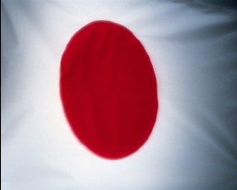
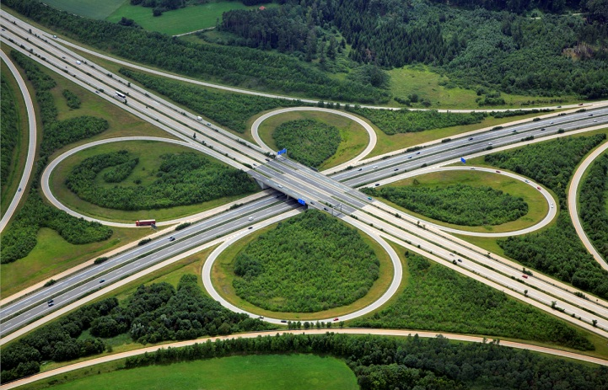
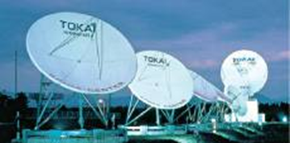
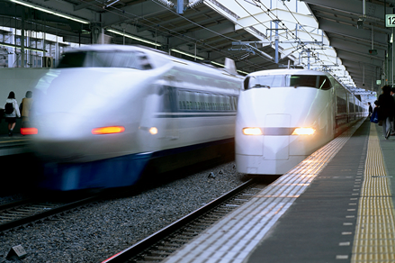
Short Term Study Abroad Programs 2012
Tokai Institute of Global Education and Research
Tokai University
“Risk Management for the 21st Century:
What We Can Learn From the Great East Japan Earthquake”
ＴＯＫＡＩ ＵＮＩＶＥＲＳＩＴＹ

Slide 2
＜＜For Engineering students＞＞
Japanese Cutting Edge Technology: Prevention of
Natural Disasters and Post-disaster Restorative Action
＜＜For Business Management students＞＞
Glocal Business Management:
Strategic Marketing and Restorative Actions by Japanese Corporations
Tokai Institute of Global Education and Research (TIGER) of Tokai University offers two special short term study abroad programs exclusively to the students of our partner universities. In the wake of the Great East Japan Earthquake, Japan has experienced damage of unprecedented scale. There has been much discussion about disaster prevention and recovery efforts. These present us a number of issues and cases concerning the risk management in the field of technology, engineering, and business management. We would like to introduce international students to these issues through lectures and field studies in order to contribute to enhanced global risk management for the future.
The timing of the program, which occurs right before the first anniversary of the earthquake provides a special opportunity for participants to engage in discussion about future risk management. We will visit disaster areas in Tohoku, but also the technical research institution which is responsible for the symbolic tower, Tokyo Sky Tree, the world’s tallest self-supporting tower, represents the restorative spirit of Japan and its earthquake-proof technology. Furthermore, participants will visit Seven Eleven Japan, an insightful example of “glocal management” which has continually supported the communities by procurement of food and logistics throughout the devastated area.
The programs consist of lectures by Tokai faculty members and field studies with experts from public and private sectors taking full advantage of Tokai University’s comprehensive academic resources and outstanding national administrative and business contacts.
These two programs have been approved by JASSO (Japan Student Services Organization), and a scholarship of \80,000 is being offered to each participant. Because the programs can accommodate only a limited number of students, there will be a selection. It is important for each applicant to ask his/her academic advisor for a letter of recommendation on which the selection will be based, together with a resume and an essay.
ＴＯＫＡＩ ＵＮＩＶＥＲＳＩＴＹ

Slide 3
The lectures (at Shonan Campus, Kanagawa) and field study (in Tokyo and Tohoku) topics may include but are not limited to:
Common Lectures
Eco Technology: Human Environment Conscious Science
The Accident at TEPCO’s Fukushima Nuclear Power Stations and the Lessons Learned from the Accident
Contemporary Interpretations of Japanese Culture
Cutting Edge Technology of Japan Lectures
Actual Conditions of the Damage by Huge Tsunami
Seismic Isolation and Control System of Structure
Disaster-relief and Japanese Robotic Technology
Observation of Natural Disasters from Satellites
Glocal Business Management Lectures
What Is Expected of Japan After the Great East Japan Earthquake?
Japanese Quality Control Management and Its Disaster Risk Control
Management of Japanese Small and Medium-sized Enterprises
Japanese Marketing Strategy after 3.11
Field Studies
- The Tallest Self-Supporting Tower in the World “Tokyo Sky Tree” and
Its Vibration Controlling System
Obayashi Corporation Technical Research Institute
- Risk Evaluation and Safety Standard for Earthquake and Tsunami
Seismic Safety Division, Japan Nuclear Energy Safety Organization (JNES)
- Glocal Business Strategy in Japan
Headquarters and Tohoku Zone, Seven Eleven Japan/Seven and i Holdings
- Damage and Restoration from the East Japan Earthquake
Observation of the Disaster Area from land and sea (a board a ship)
Tohoku Regional Bureau, Ministry of Land, Infrastructure and Transport
- Japanese Culture and History
Edo-Tokyo Museum
*Please note that we will visit the Tohoku disaster areas which were damaged
by the earthquake and tsunami. However, we will not be visiting the restricted
areas affected by the Fukushima nuclear power plant.
ＴＯＫＡＩ ＵＮＩＶＥＲＳＩＴＹ

Slide 4
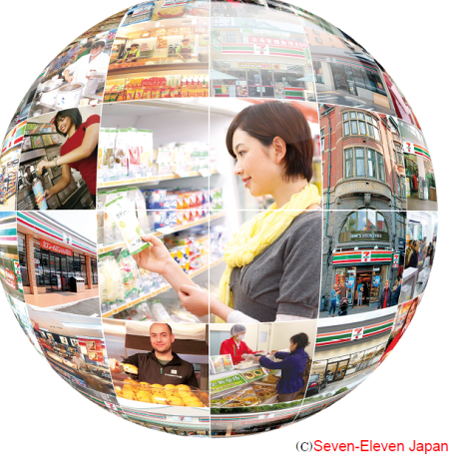
Tokai Institute of Global Education and Research
Tokai University
Short Term Study Abroad Programs 2012
Period: February 21, 2012 to February 29, 2012 ( 9 days)
Participation Fee: \60,000
*This fee covers tuition, 8 nights’ accommodation,
and transportation costs.
*Each participant is eligible for the JASSO scholarship of \80,000
Accommodations: Business hotels and a school dormitory
Requirement: Enrollment in a partner university of Tokai University
Ability to participate in classes conducted in English
Application Deadline: January 14, 2012
Application should include: -Resume,
-Essay: “Why I Would Like to Participate in This Program”
-A letter of recommendation from an academic adviser
Application Submission: Students need to submit the above mentioned application
materials by e-mail attachment to International Planning and
Operations Department, Tokai University as below:
Tadashi MITSUHASHI
International Planning and Operations Department
Tokai University
E-Mail: mt069120@tsc.u-tokai.ac.jp
ＴＯＫＡＩ ＵＮＩＶＥＲＳＩＴＹ

